Slide 1
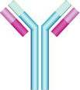
Immunology Biol 465 Minot State University Spring 2020
MWF 9-9:50 am
Lab Tuesdays 9am-noon

Slide 2
Lecture 2 January 17, 2020
Course organization and information:
Website--http://msubiology.info/node/39
Any trouble accessing and using?---Let’s explore some resources.
Please turn in your assignment?

Slide 3
Where were we?
What is immunology?
What are some cells mentioned in the first lecture, that have an immune response role? Draw them like your text.
What types of pathogens must the immune system deal with? Name a couple, and the diseases caused by them.
What are the 2 primary types of immune responses? Which occurs earliest when we take in a pathogen?
What do we mean by self and non-self, in immunology?

Slide 4
2 basic types of immune responses
1. Innate immune response
Rapid (minutes to hours)
*Non-specific—but directed against pathogens
Requires no previous exposure to pathogen
Does not induce immunological memory (the ability the immune system to rapidly engage to kill a pathogen that has infected the host before).
Found in some form in nearly all plants and animals.

Slide 5
2. Adaptive immune response
Acquired after previous exposure to pathogen
Slow(weeks) to develop (at initial exposure)
Very specific—cells involved recognize a specific pathogen and even a very specific part of the pathogen, which we call an antigen.
Responses seen in jawed vertebrates (fairly recently evolved trait)

Slide 6
Innate responses precede adaptive responses
Within hours of acquiring a pathogen, specific cells (like macrophages) can “see” something about the pathogen that distinguishes it from cells of the host (self). This is called immunological recognition. The macrophage cell may do a number of things to start to eliminate the pathogen.

Slide 7
Examples?...
1. Macrophages are phagocytes---can move gobble up some pathogens or components of pathogens.
2. Macrophages can initiate a series of events known as inflammation. Inflammation can contain (wall off) a pathogen and prevent spread of the pathogen.

Slide 8
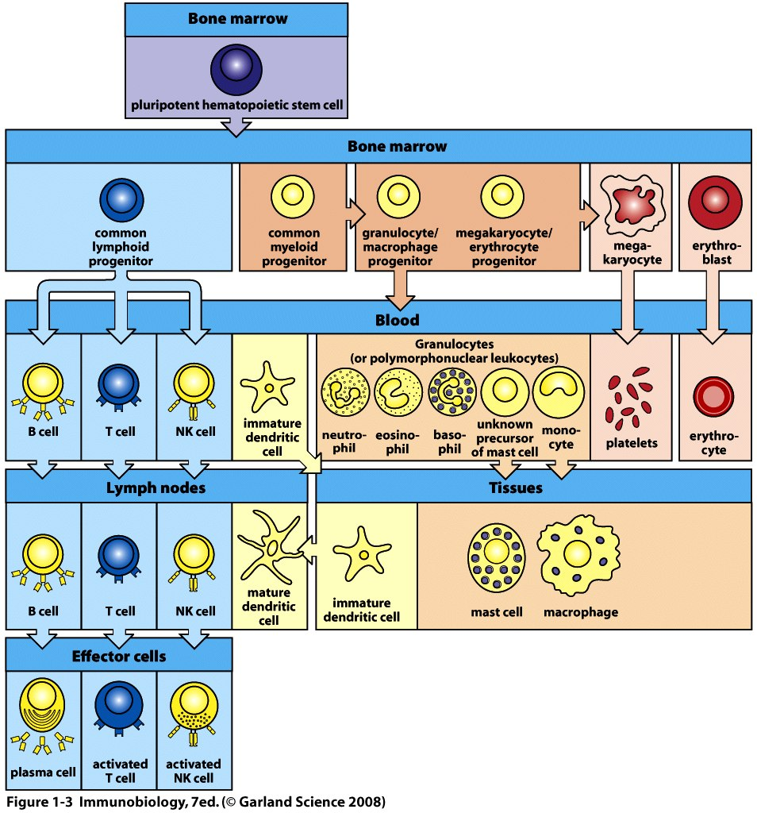

Slide 9
Cells directly involved in innate immunity
Lymphocytes

Slide 10
Adaptive immunity follows innate immunity and involves lymphocytes. Innate responses trigger adaptive responses which may take 2 or more weeks to peak.
Example? Macrophages “show” bits of a pathogen to lymphocytes which respond with “YIKES… lets get serious about killing this invader”

Slide 11
Cells directly involved in adaptive immunity

Slide 12
Eventually activities of lymphocytes rid the body completely of the pathogen.
Even better…the host is now primed to act quickly and powerfully if the pathogen is encountered again.
Even, even better…the host’s immune system will remember this pathogen for a long time—maybe for the life of the host. Immunological memory.

Slide 13
This is the basis of most immunizations!
Exposure to an antigen from a pathogen—usually rendered harmless, but biologically intact/active. (e.g. a killed virus, or specific viral protein)
Initiation of immune response
Innate
Adaptive
Development of immunological memory so that the pathogen will not establish a harmful infection when encountered

Slide 14
Once immunological memory is established, reinfection with the same pathogen induces a rapid, adaptive response (without need for innate immune response).
The immune system is said to be primed for recognition of that pathogen.

Slide 15
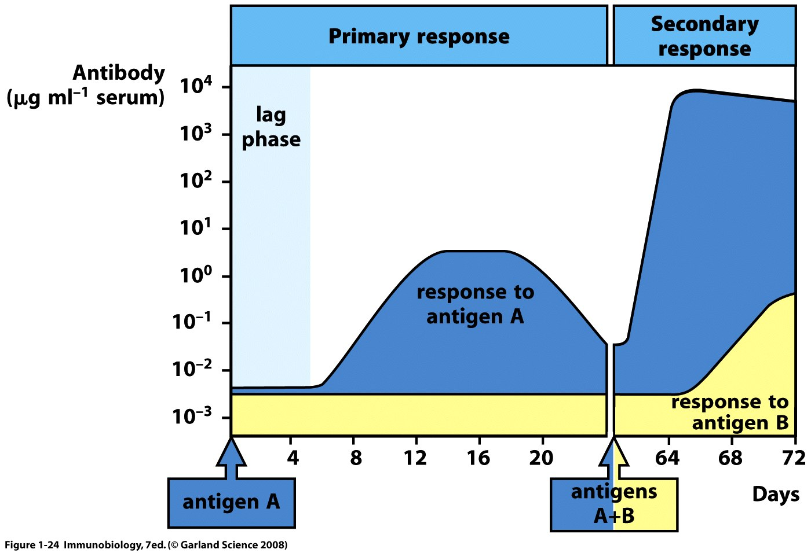
Figure 1-23
Antibodies are produced by B-lymphocytes

Slide 16
Before we move on…let’s define just what it is that allows cells of the immune system to recognize someting as “not self”.
Some molecule or structure of the pathogen is physically bound by a receptor on one or more cells of the immune system.
The pathogen part is known as the antigen

Slide 17
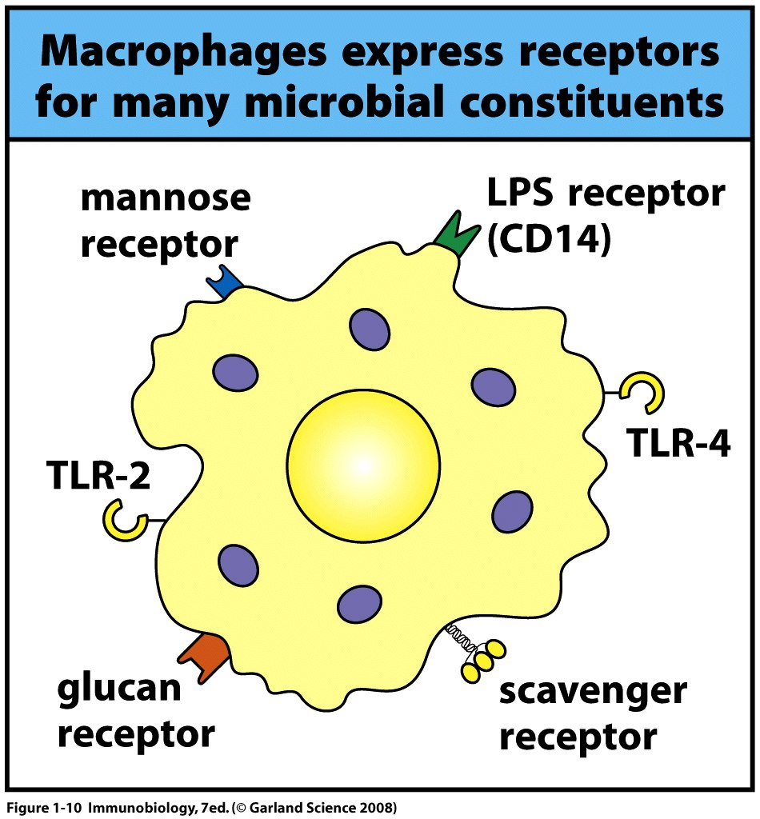

Slide 18
Adaptive immunity requires that B- and T- lymphocytes have very specialized receptors for recognizing pathogens/antigens.
These are called antigen receptors
Each antigen receptor can bind to one specific antigen
The specific part of the antigen that is bound by the antigen receptor is called the epitope of the antigen.

Slide 19
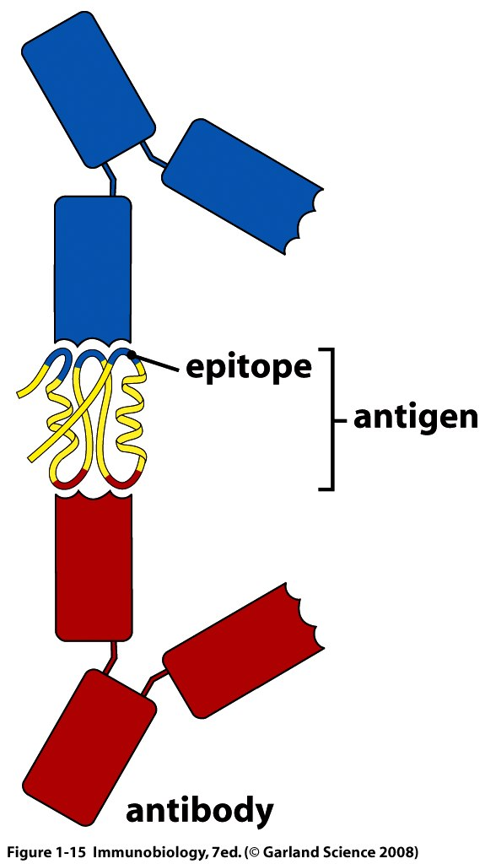
Different antibodies recognizing 2 epitopes of the same antigen
B-cells recognize antigens through antibodies that are anchored in their cell membranes. Later, those same antibodies are released and circulate in the blood.

Slide 20
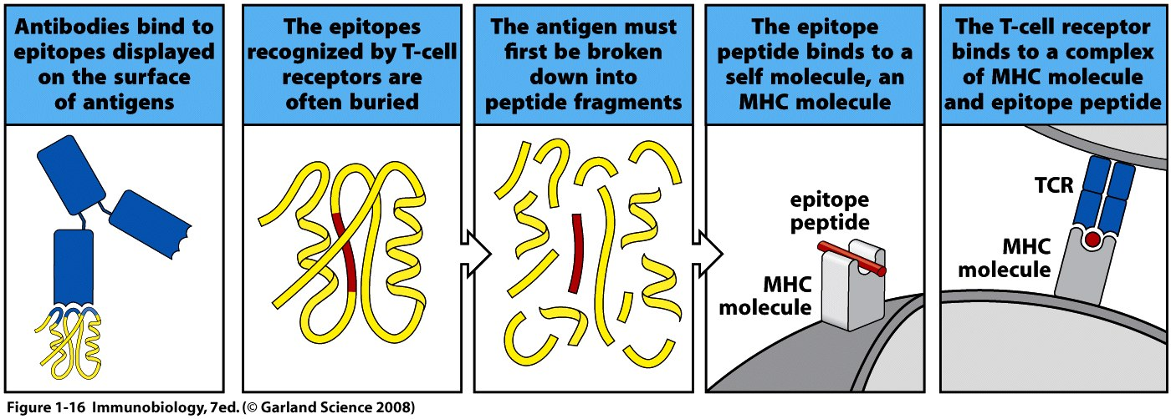
How B-cells and T-cells see antigens.

Slide 21
One major difference:
B-cells (with anchored antibody receptors) can bind to soluble/free, intact antigen.
T-cells can bind to a tiny component of a larger antigen AND the antigen must be presented to it by another cell.

Slide 22
Each B- and T- cell has a slightly different antigen receptor that allows it to “see” a different antigen. (or different epitope of the same antigen)
This explains the incredible specificity of the adaptive response.

Slide 23
Since both B and T cells can play a role in the adaptive immune response, we distinguish their unique types of activities.
B-cells—produce antibodies that circulate in the plasma/liquid part of the blood. Blood was once called humor. B-cells provide humoral immunity

Slide 24
T-cells—act directly or indirectly to kill pathogen-infected host cells.
Called cell-mediated immunity

Slide 25
Normal immune responses are a delicate balance of recognizing a pathogen and responding appropriately and at the same time, ignoring tissues, cells, molecules that belong to the host.
Called self tolerance

Slide 26
Inappropriate immune responses come in 2 basic forms.
1. Autoimmunity---failure to establish self tolerance. An individual mounts an immune response against body tissue.
Lupus
Multiple Sclerosis
Rheumatoid athritis
Graves disease
Diabetes

Slide 27
2. Immune failure
Immunodeficiency
Immunosuppression
Normal in babies and elderly
Can be caused by the pathogen itself
Can be caused by medication
Can be inherited genetic defect

Slide 28
Extreme example
Severe Combined Immune Deficiency
SCID
Individual makes no B or T cells. No adaptive immune response at all. Very serious.
“Bubble Boy” disease.

Slide 29
Final thought in our introduction.
The study of immunology has allowed development of amazingly specific technologies based on the specificity of antigen and antigen receptors.

Slide 30
Example
Antibodies can be used in medical diagnostics, treatment, and monitoring…
If you purify antibodies that detect a pathogen or molecule of interest say…the HIV virus or its proteins, you can use those antibodies to detect HIV in a person’s blood.
The antibody can be altered in a way to make it visible. (like adding a fluorescent molecule)

Slide 31
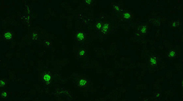
Immunofluorescence

Slide 32
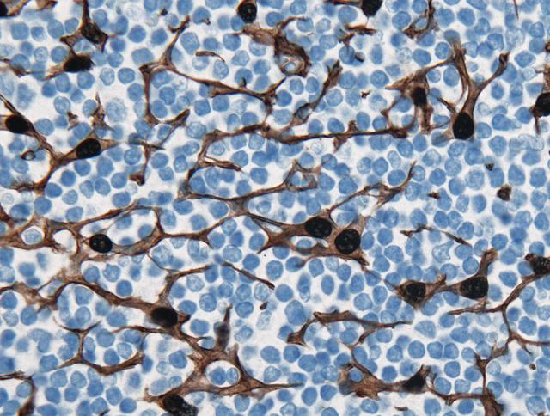
Immunohistochemistry

Slide 33
Antibodies can even block normal interactions of cell receptors and their ligands (things that bind receptors).
Some disease treatments include antibodies to block receptors.
Breast cells can be blocked from binding estrogen which can make them divide abnormally---breast cancer. Basis of a drug called Herceptin

Slide 34
Immune checkpoint blockade therapy uses antibodies to block the normal receptors that suppress immune T-cells from killing cancer cells. The block—by binding antibodies releases the brakes on the immune system.
Anti-PD-1 therapy is treatment with antibodies that bind to PD-1.

